Slide 1
SeaSPRITE Python Final Project
Blesson Reji, Elizabeth Vitug, Jabbar Lewis
Fall - 2025

Slide 2
Background
This project serves two purposes: it fulfills the requirements of our Python final project while directly integrating into our engineering capstone, developed in partnership with the Naval Surface Warfare Center (NSWC).
The capstone is a multi-semester engineering initiative aimed at modernizing the existing "SeaGlide" educational platform by replacing its original wired controller with a fully engineered wireless control system.
Programming the microcontrollers lets us watch our code cross from the digital domain into the physical world (by making motors spin and turn, and facilitating wireless communication), which is one of the most exciting parts of embedded engineering.

Slide 3
Hardware
Esp32 Dev Board
Acts as the main controller for the boat
Provides onboard WIFI for communication between transmitter and receiver
Dual H-Bridge motor Driver
Control the DC motor direction and speed
Uses PWM form the ESP32 for Variable speed control
Battery
Joystick
Hall Sensors

Slide 4
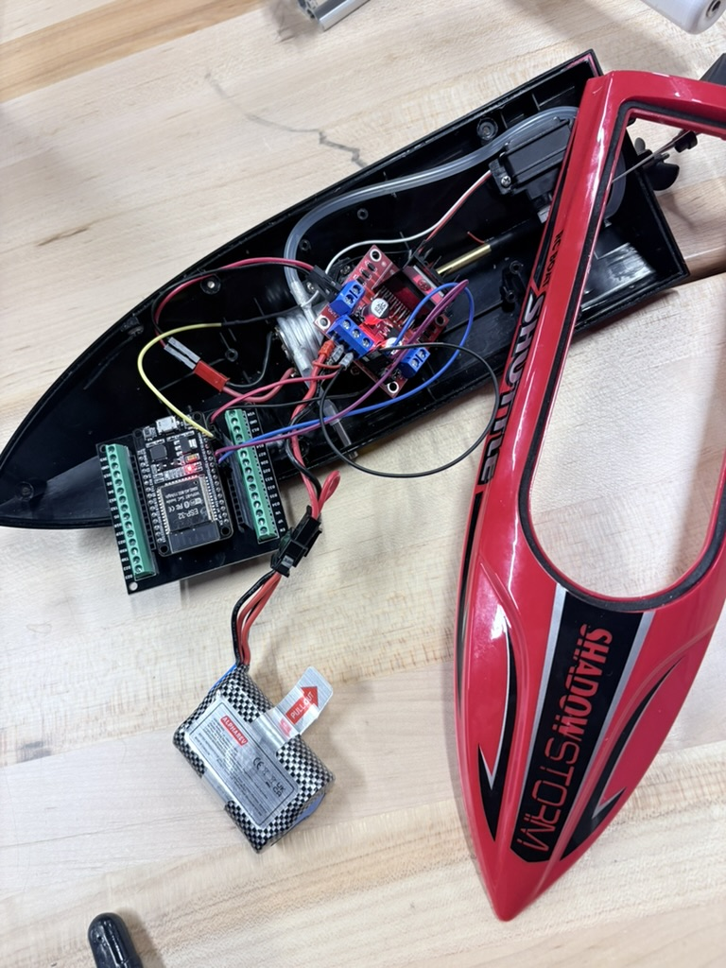




Hardware- Fig-1
Boat
H-Bridge
ESP32
Battery 7.4V

Slide 5
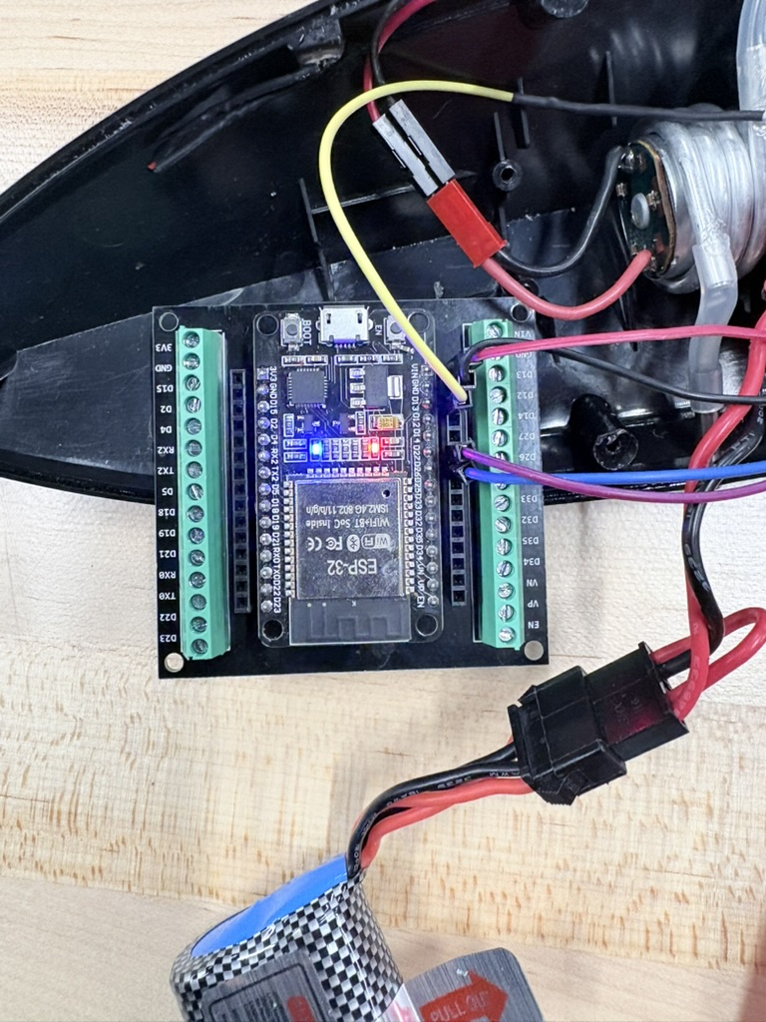
Hardware- Fig-2

Slide 6
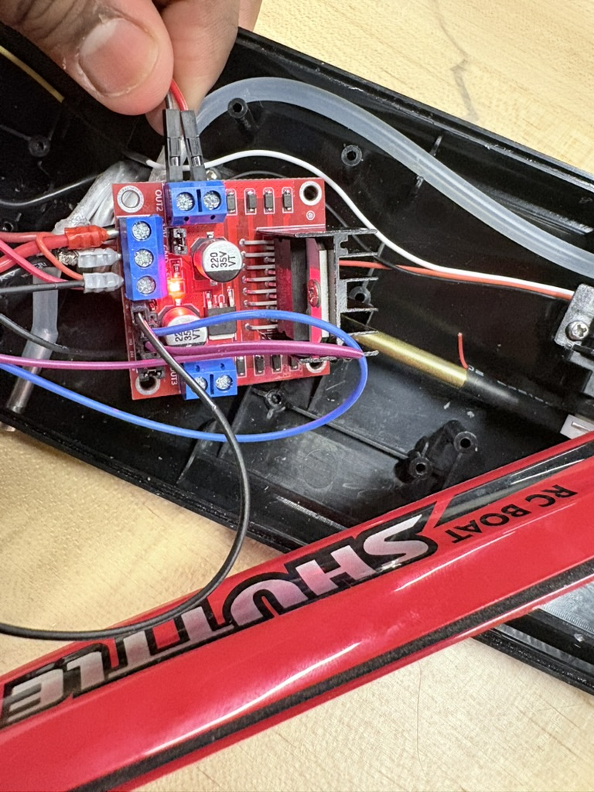
Hardware- Fig-3

Slide 7
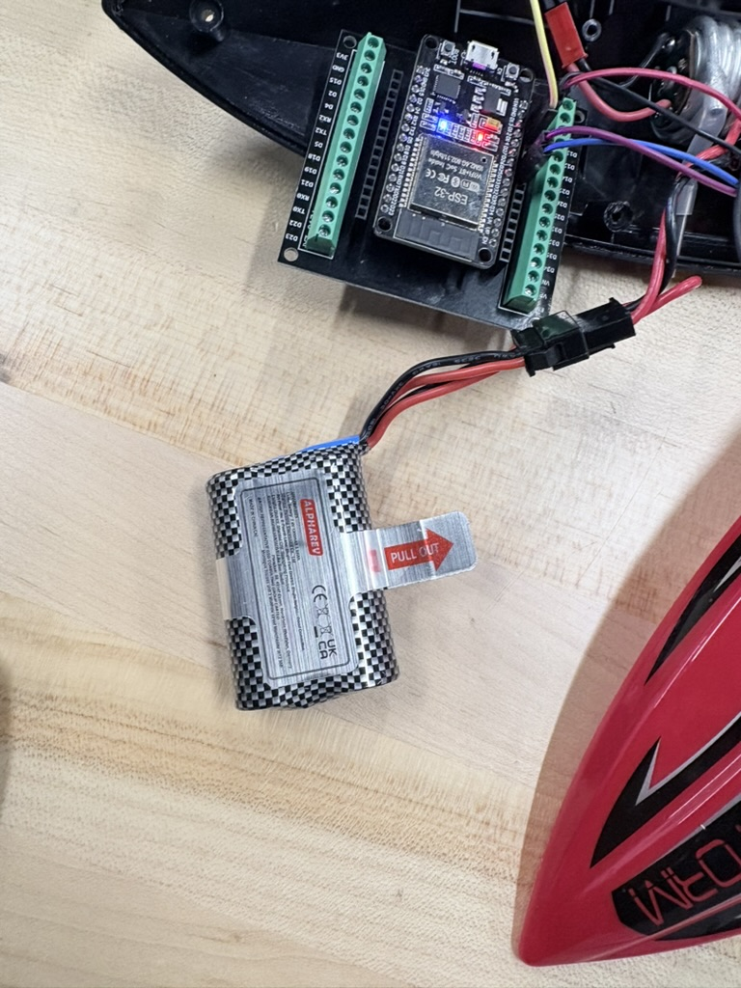
Hardware- Fig-4

Slide 8
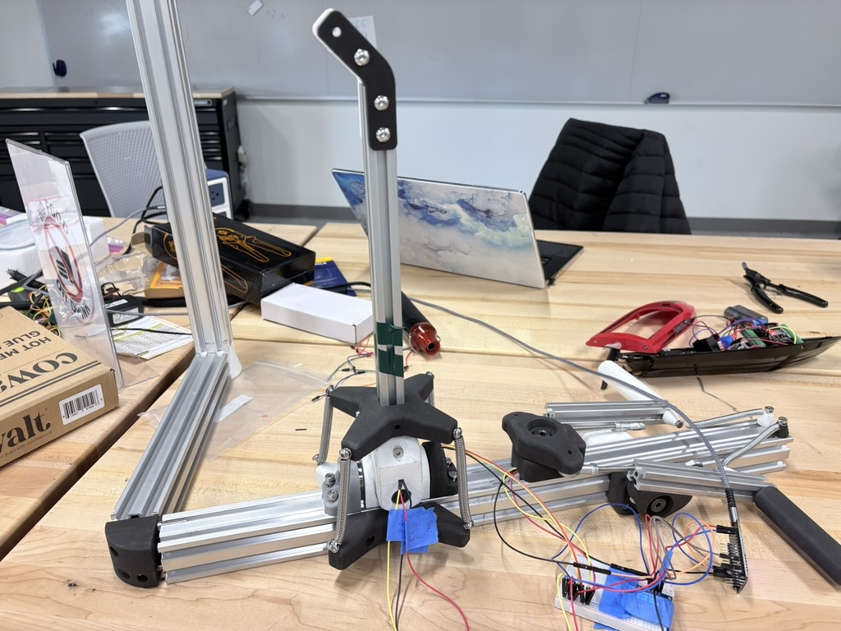

Hardware- Fig-5
Hall Sensor
Notes:
detects magnetic fields and converts them into electrical signals

Slide 9
Software
The Capstone project does not use Python instead it uses Arduino C++.

Slide 10
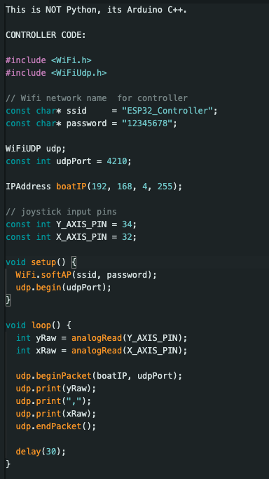
Software-Fig-1

Slide 11
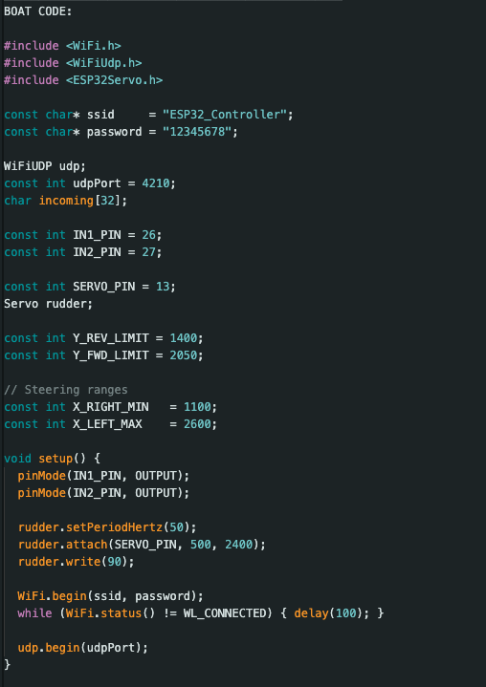
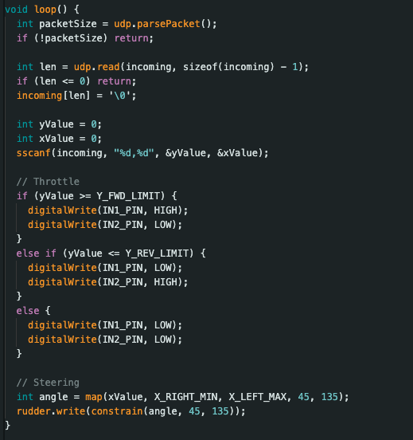
Software-Fig-2

Slide 12
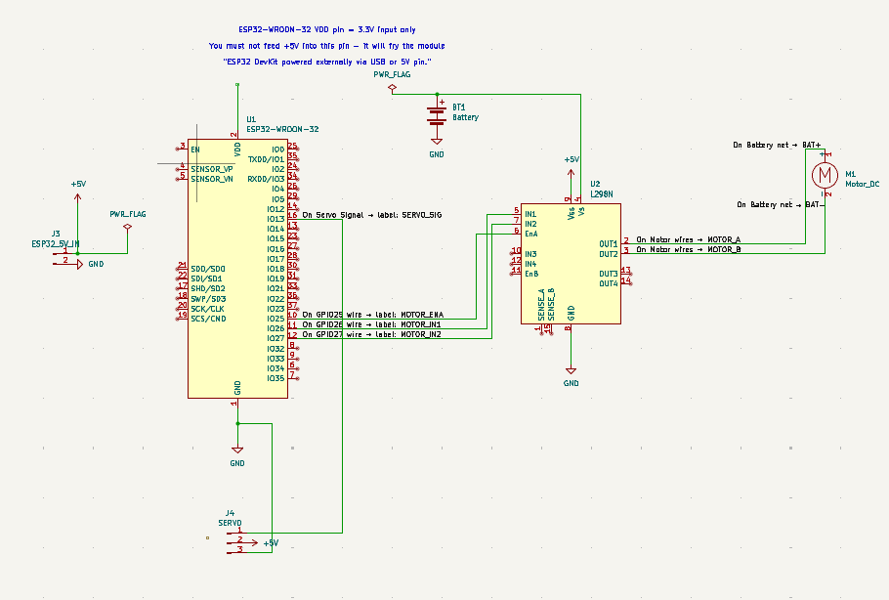
Software-Fig-3

Slide 13

Video

Slide 14
Conclusion
By combining our Python final with our capstone, we create a complete engineering system that includes hardware with a software analysis tool
Challenges encountered:
WIFI communication Instability
Joystick
Time

Slide 15
Reference & links
https://github.com/Blessonreji539/SeaSprite----Temple-University----NAVSEA----Capstone-

